Slide 1
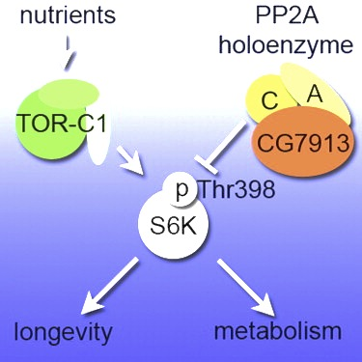
PP2A-B’ is a negative regulator of S6K in Drosophila
Hahn et al, Cell Metab. 2010

Slide 2
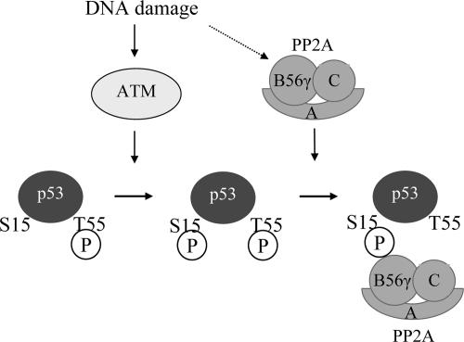
Mammalian PP2A-B’ homolog is PPP2R5C
Shouse et al, Mol Cell Biol. 2008
Notes:
Thr55 dephosphorylation is required for B56gamma3-mediated inhibition of cell proliferation and cell transformation, S15 phosphorylation is required for desphosphorylation at T55

Slide 3
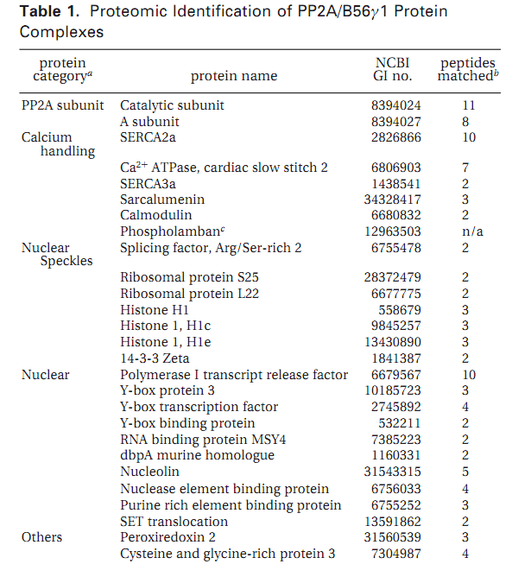
Proteomic study reveal multiple PPP2R5C containing complexes
Zhou et al, J Proteome Res. 2007

Slide 4
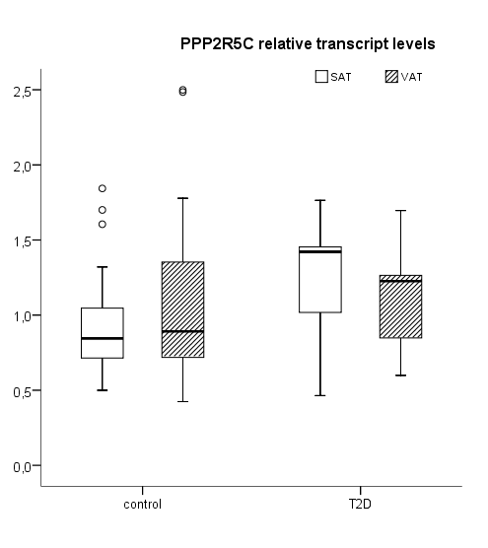
Clinical Data show mis-regulation of PPP2R5C in Type 2 Diabetes
Clinical Data from collaborators
Notes:
Type 2 diabetes enhances the gene expression of PPP2R5C in subcutaneous adipose tissue (but not in visceral adipose tissue)

Slide 5
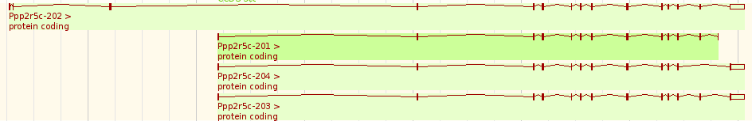
Gene structure of mPPP2R5C
Primer set | 1 | 2 | 3 | 4 | Long
Isoforms | 1,5,10(total) | 2,9(short) | 3,4,7,8(total) | 4,5,8(long) | long

Slide 6
Long isoforms of PPP2R5C is upregulated in liver during fasting
Notes:
Fasted for 24 hrs, refed 6 hrs

Slide 7
PPP2R5C is upregulated in muscle after refed

Slide 8
PPP2R5C is not metabolically responsive in adipose tissue

Slide 9
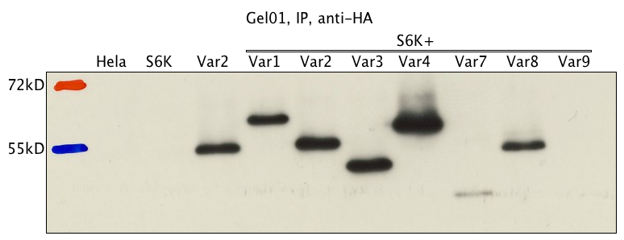
No interaction between S6K1 and PPP2R5C could be detected
α-HA
Notes:
Hela, 293T, crosslinking, detergent(triton x-100, CHAPS)

Slide 10
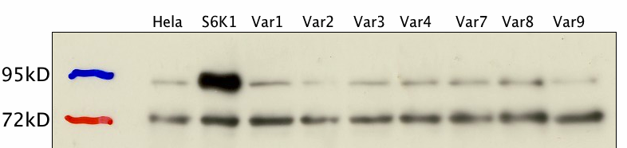
p-S6K is unaffected by overexpression of PPP2R5C
α-p-S6K

Slide 11
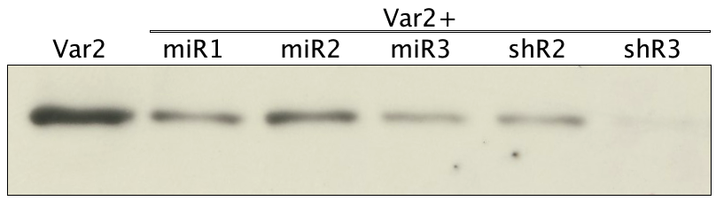
Most shRNA and miRNA candidates have efficient knockdown on PPP2R5C
PPP2R5C
Var2-HA
anti-HA
Notes:
----- Meeting Notes (11-4-6 15:46) -----
8:1 ratio shR or miR/RL

Slide 12
Selecting shR3 to package adenovirus

Slide 13
miR2 could be possible candidate for miRNA knockdown
Notes:
Liver specific promoter

Slide 14
Initial knockdown of PPP2R5C in liver

Slide 15
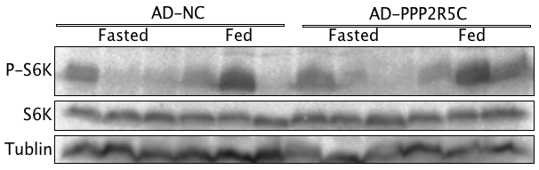
No change of pS6K in liver

Slide 16
Virus load is comparable

Slide 17
Increasing virus load has marginal knockdown
Notes:
Difference in targeting different isoforms, Taqman for all, 3 for 3,4,7,8.
----- Meeting Notes (11-8-26 10:28) -----
check ppp2R5c in hepa with PBS

Slide 18
Liver PPP2R5C does not change after AAV infection

Slide 19
AD-PPP2R5C has 80% knockdown in Hepa

Slide 20
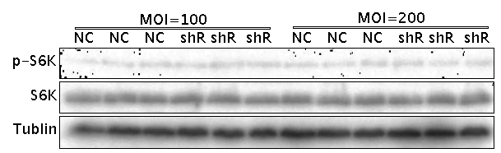
No significant change p-S6K in Hepa 1-6

Slide 21
No significant change p-S6K in Hepas

Slide 22
PPP2R5C 80% knockdown in primary hepatocyte

Slide 23
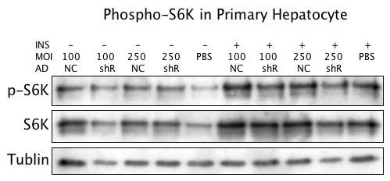
No change p-S6K in primary hepatocyte

Slide 24
Glucose consumption increases in AD-PPP2R5C infected Hepa

Slide 25
Lactate production increases in AD-PPP2R5C infected Hepa

Slide 26
Glucose consumption increase in primary hepatocyte

Slide 27
Lactate production does not correlate with glucose consumption in primary hepatocyte

Slide 28
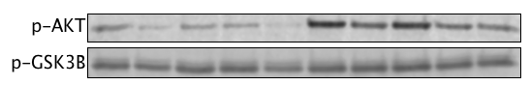
GSK3b is not responsible for the glucose phenotype

Slide 29
Reduction of p-Akt with PPP2R5C knockdown

Slide 30
Upregulation of mPKM2 with PPP2R5C knockdown

Slide 31
Overexpression of PPP2R5C in Hepa 1-6

Slide 32
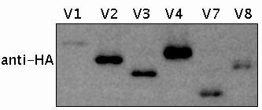
PPP2R5C with HA detection

Slide 33
Overexpression of PPP2R5C decrease glucose metabolism
Notes:
Relative to total protein content
Need to be done more carefully to get publishable results

Slide 34
PKM2 decrease with PPP2R5C overexpression

Slide 35
Relative capacity of PPP2R5C isoforms

Slide 36
Overexpression or knockdown of PPP2R5D in hepa 1-6

Slide 37
PPP2R5D has no effect on glucose metabolism

Slide 38
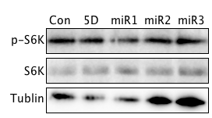
Inconsistent change of p-S6K in Hepa 1-6

Slide 39
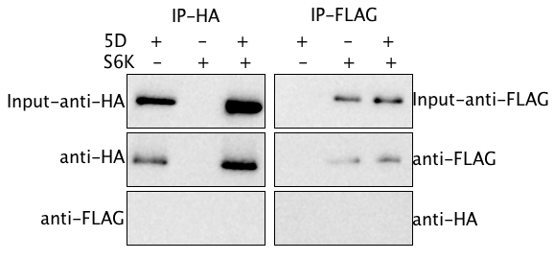
No direct interaction between 5D and S6K

Slide 40
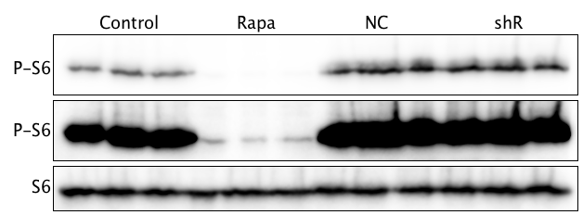
No change in p-S6

Slide 41
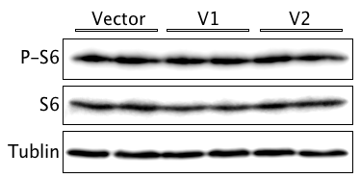
No change in p-S6

Slide 42
Lactate production in primary hepatocyte

Slide 43
Glucose consumption in primary hepatocyte

Slide 44
Knockdown efficiency is sufficient

Slide 45
Glycolytic activity in primary hepatocyte

Slide 46
Glycogen in primary hepatocyte

Slide 47
TAG increases after PPP2R5C knockdown

Slide 48
No ATP change in primary hepatocyte

Slide 49
Acetyl CoA syntheis activity upregulated

Slide 50
Controversy change of fatty acid synthesis

Slide 51
No change in Fatty acid oxidation

Slide 52
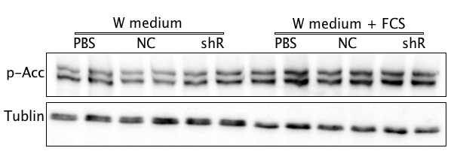
No change in p-ACC

Slide 53
Slightly change in TAG in Hepa 1-6

Slide 54
TAG increases after PPP2R5C knockdown

Slide 55
PPP2R5C is misregulated in hepatosteatosis model

Slide 56
Triglyceride storage phenotype is already developed in 48hrs

Slide 57
Increased Triglyceride storage is not due to free fatty acid uptake

Slide 58
Intracellular free fatty acid does not change

Slide 59
Triglyceride storage is also increased in primary hepatocyte

Slide 60
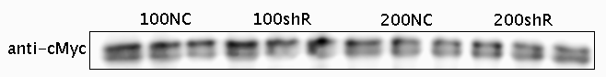
C-Myc is not changed after Knockdown of PPP2R5C

Slide 61
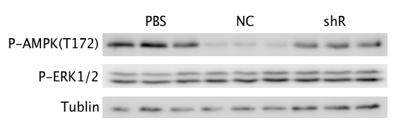
P-AMPK is upregulated

Slide 62
No change in p-ACC

Slide 63
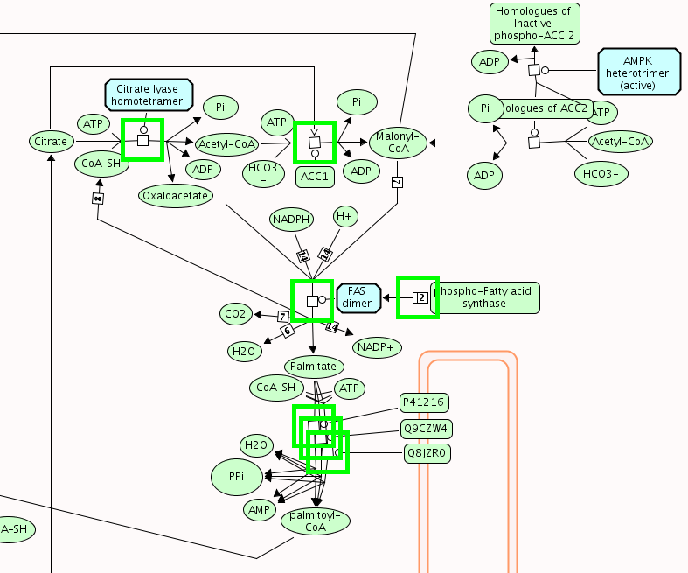
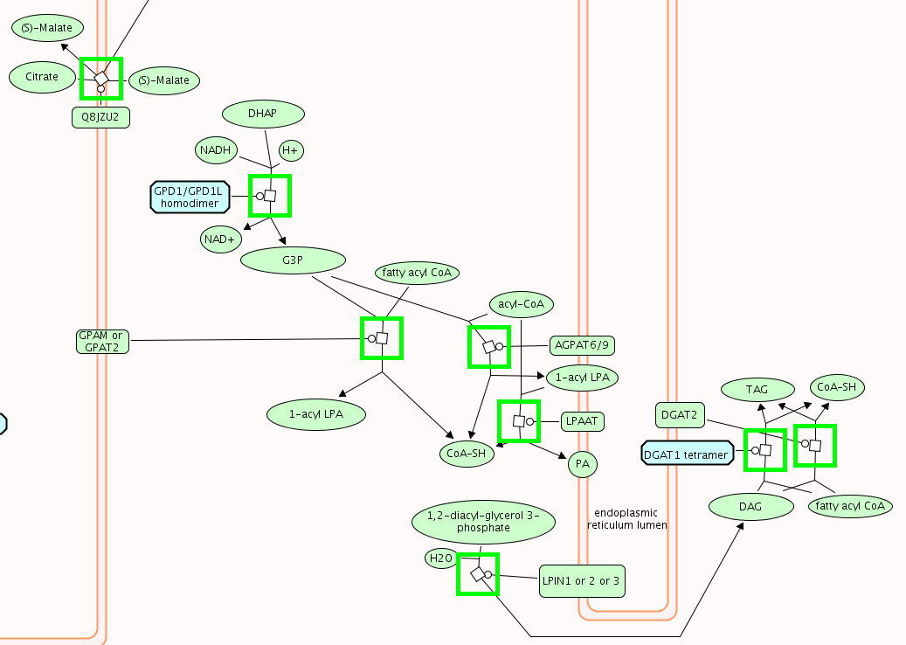
Regulation in triglyceride biosynthesis

Slide 64
GPAT, the first step in TAG biosynthesis, is increased

Slide 65
Acly, for systhesis of acetyl-CoA, is increased

Slide 66
The citrate transporter is increased

Slide 67
DGAT2, the final step in TAG biosynthesis, is increased

Slide 68
Selecting right ratio for FL/RL reporter of SREBP

Slide 69
Different load of plasmid change the response of reporter

Slide 70
PPRE reporter does not change after knockdown

Slide 71
SREBP promoter reporter does not change

Slide 72
No change in another PPRE reporter

Slide 73
GPAT SRE and LXR reporter do not change

Slide 74
Slc25a1 and GPAT promoter response to knockdown

Slide 75
Slc25a1 and GPAT promoter response to knockdown

Slide 76
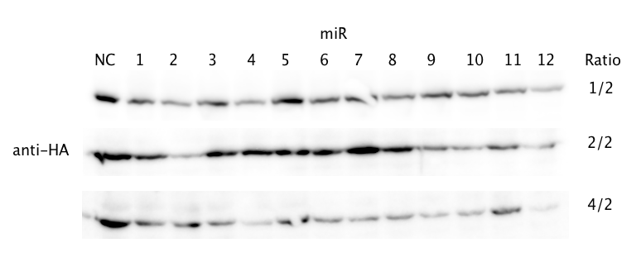
Selecting miR12 for AAV mediated knockdown

Slide 77
Quantification of miRs’ Knockdown

Slide 78
Substrate trapping

Slide 79
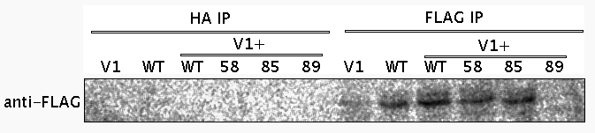
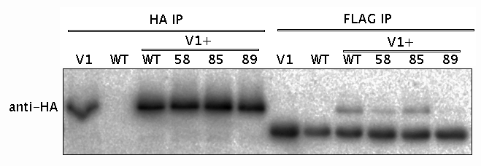
PP2A catalytic mutant interacts with PPP2R5C

Slide 80
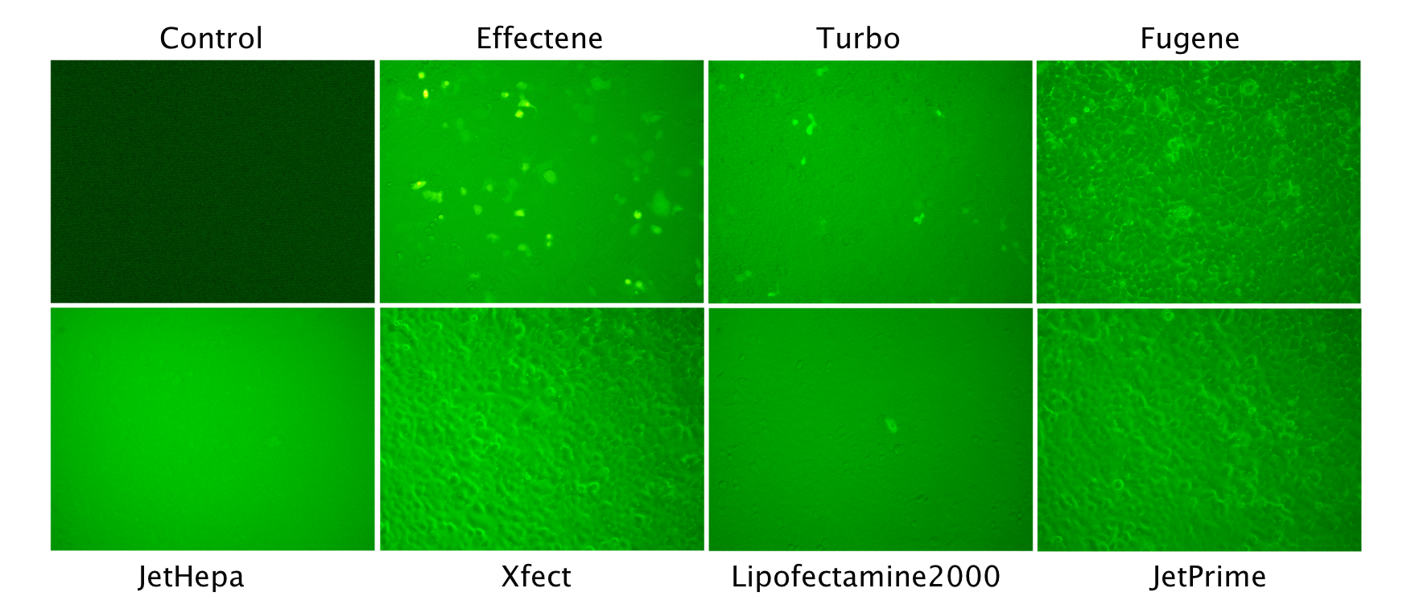
Select Effectene as best transfection reagent

Slide 81
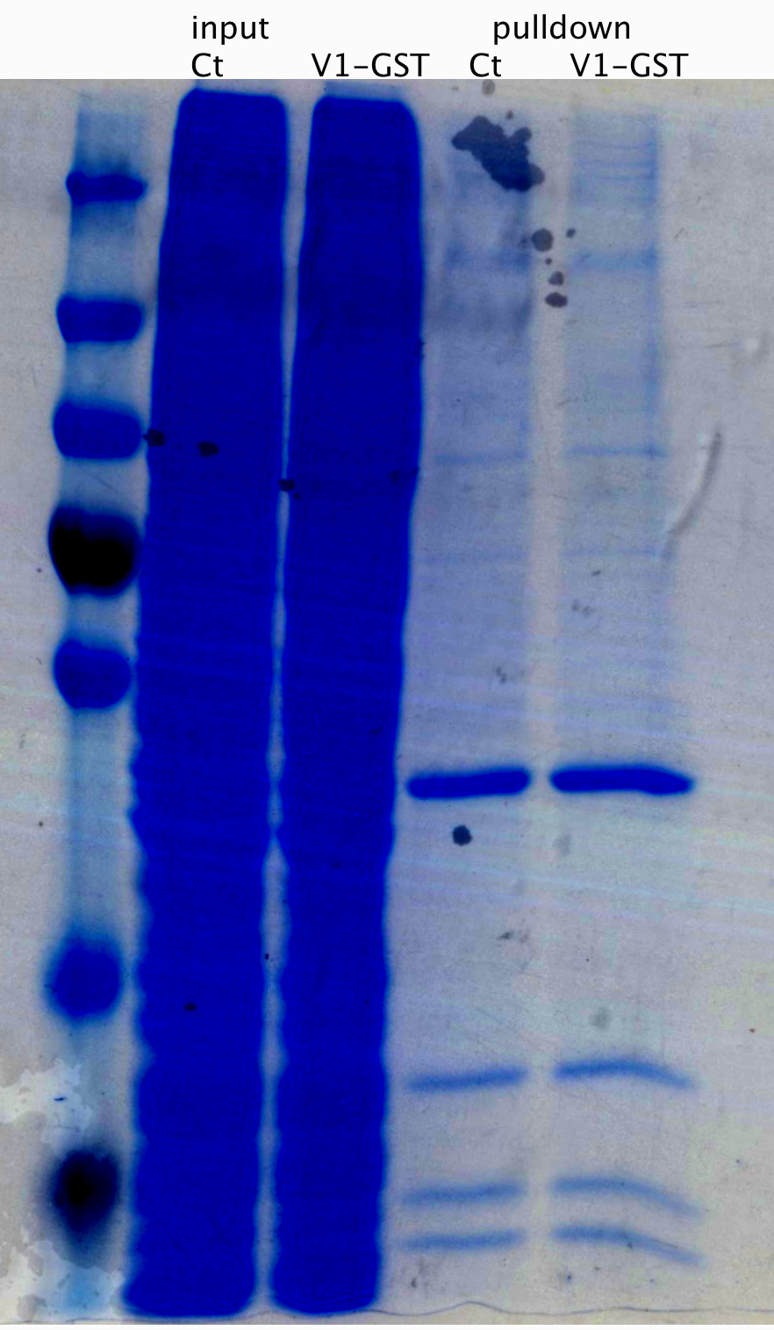
Initial trial with GST pulldown

Slide 82
Transfection of shR and miR phenocopy increased lipogenesis

Slide 83
Glycolysis phenotype is not reproducible

Slide 84
Rapamycin treatment decrease Protein synthesis

Slide 85
PPP2R5C’s TAG phenotype is mTOR independent
Notes:
Knocking down PPP2R5C is like an amplifier for lipogenesis.

Slide 86
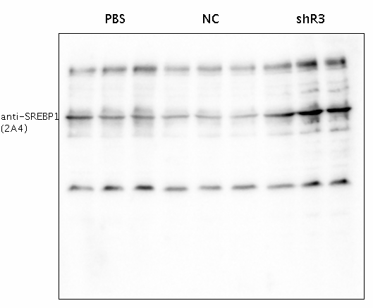
SREBP-1 change is not reproducible

Slide 87
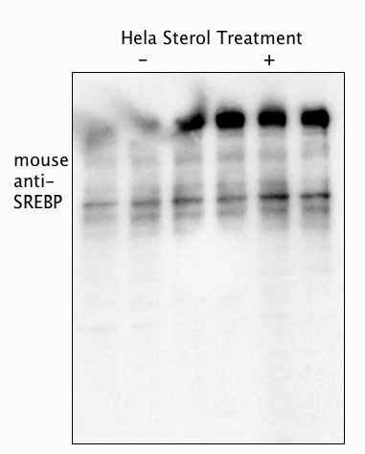
Anti-SREBP1 not response to Sterol treatment

Slide 88
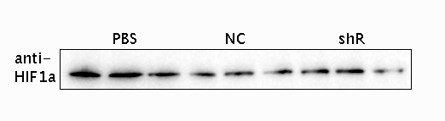
Hif1a is not significantly upregulated

Slide 89

PPP2R5C negatively modulate AMPK

Slide 90
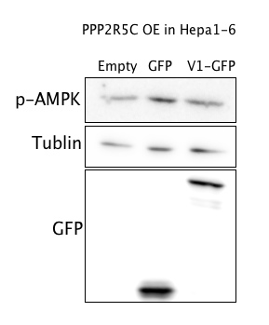
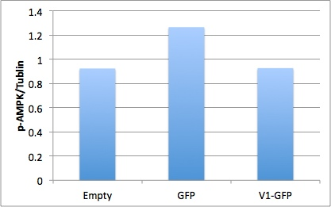
PPP2R5C negatively modulate AMPK

Slide 91
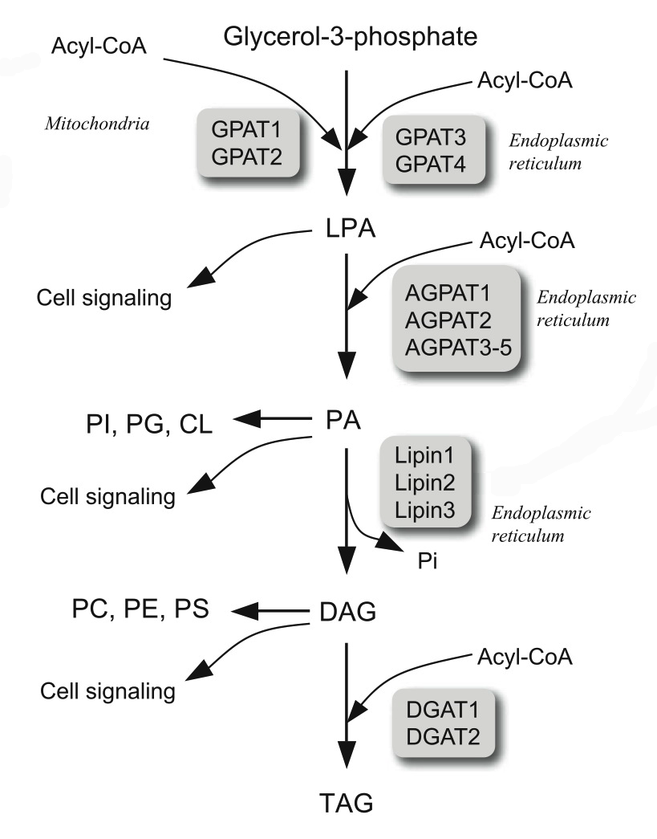
Regulation in triglyceride biosynthesis
Takeuchi And Reue, Am J Physiol Endocrinol Metab, 2009
Notes:
Dissect pathway in TAG biosynthesis. Lysophosphatic acid. A lot of signaling molecule in these intermediates. DAG for pkc, PA for mTOR. Binding tor.

Slide 92
Acly, for systhesis of acetyl-CoA, is increased

Slide 93
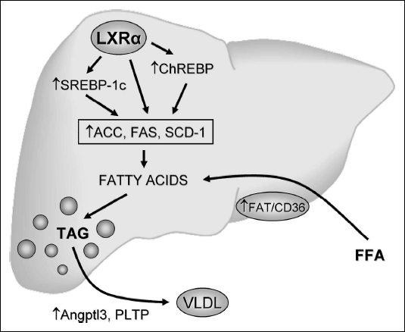
Known Pathway Controling Lipogenesis
PPP2R5C
℗-X
Lipogenesis
Baranowski, J Physiol Pharmacol., 2008
Notes:
Nuclear receptor control several bHLH transcription factor for ligogenesis.

Slide 94
Acly upstream stucture
Klhl11
Acly
Ttc25
22k Genomic region chopped into 5 fragment + promoter for reporter assay
Notes:
Neighbouring gene is not afftected in KD

Slide 95
Promoter region is not responsible for upregulation

Slide 96
Upsteam of Acly in response to PPP2R5C KD

Slide 97
Further fragmentation on Acly up6
Klhl11
Acly
Ttc25
Acly up6 frags
Fragmentation
2.3k
Identify TFs
6-1
6-2
1.1k
Identify PPP2R5C Targets

Slide 98
Acly up6 fragments response to PPP2R5C knockdown

Slide 99
Top-down Target Selection
Substrate Trapping for PPP2R5C
Notes:
Ppp2a catalytic subunit active center. Metal ion depend enzyme. Mutant destabilized metal ion chelating or amino acid for charge transfer. 3 mutant, all binding with ppp2r5c and reported to be dead mutant.

Slide 100
BioID protein interaction mapping
Roux et al, J. Cell Biol., 2012

Slide 101
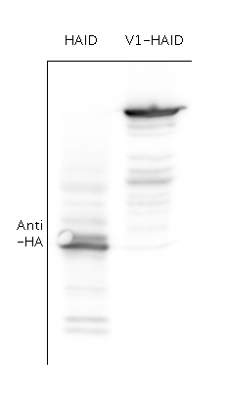
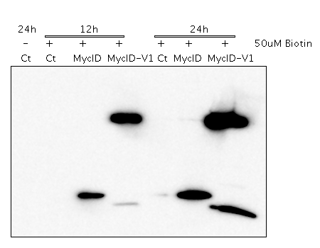
BioID-PPP2R5C fusion is expressible

Slide 102
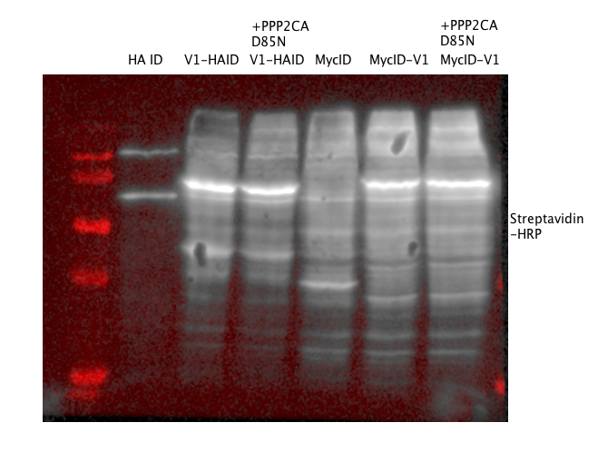
Protein biotinylation is different with PPP2R5C fusion

Slide 103
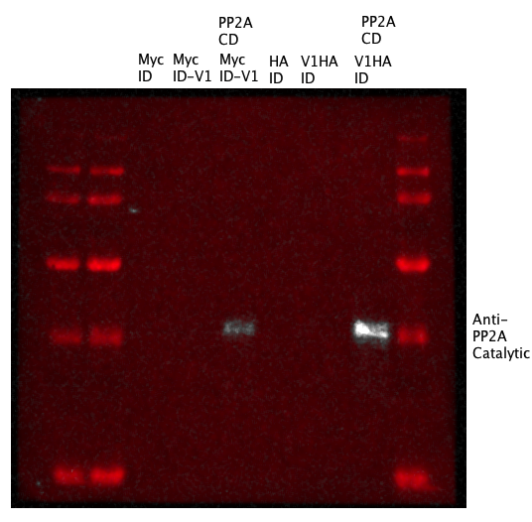
PP2A catalytic subunit is fished out

Slide 104
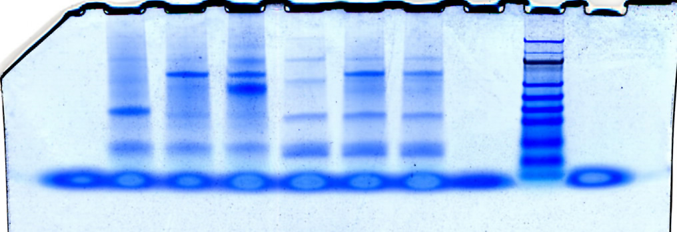
Large scale streptavidin pulldown is successful
MycID-V1+D85N
V1-HAID+D85N
MycID-V1
HAID
V1-HAID
MycID

Slide 105
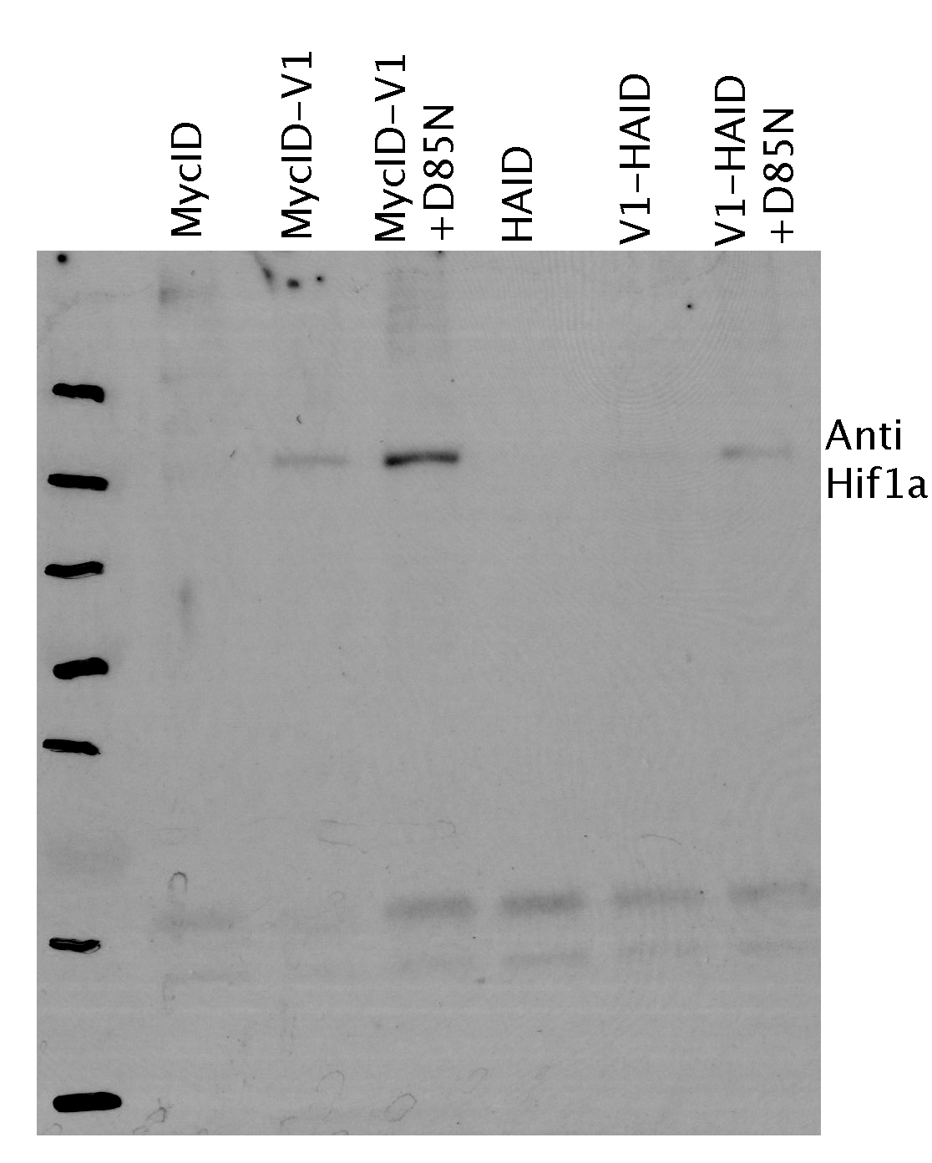
Hif1a interacts with PPP2R5C
Notes:
Not srebp

Slide 106
What is HIF1a?
Normoxia
Hypoxia
HIF1a
PHD + O2
MAPK?
OH
P
HIF1a
HIF1a
CBP/p300
OH
P
HIF1a
HIF1a
HIF1b
Ub
Ub
Ub
Ub
Ub
HRE
Target gene
Proteasome mediated degradation
Glycolysis, lipogenesis, metastasis, survival

Slide 107
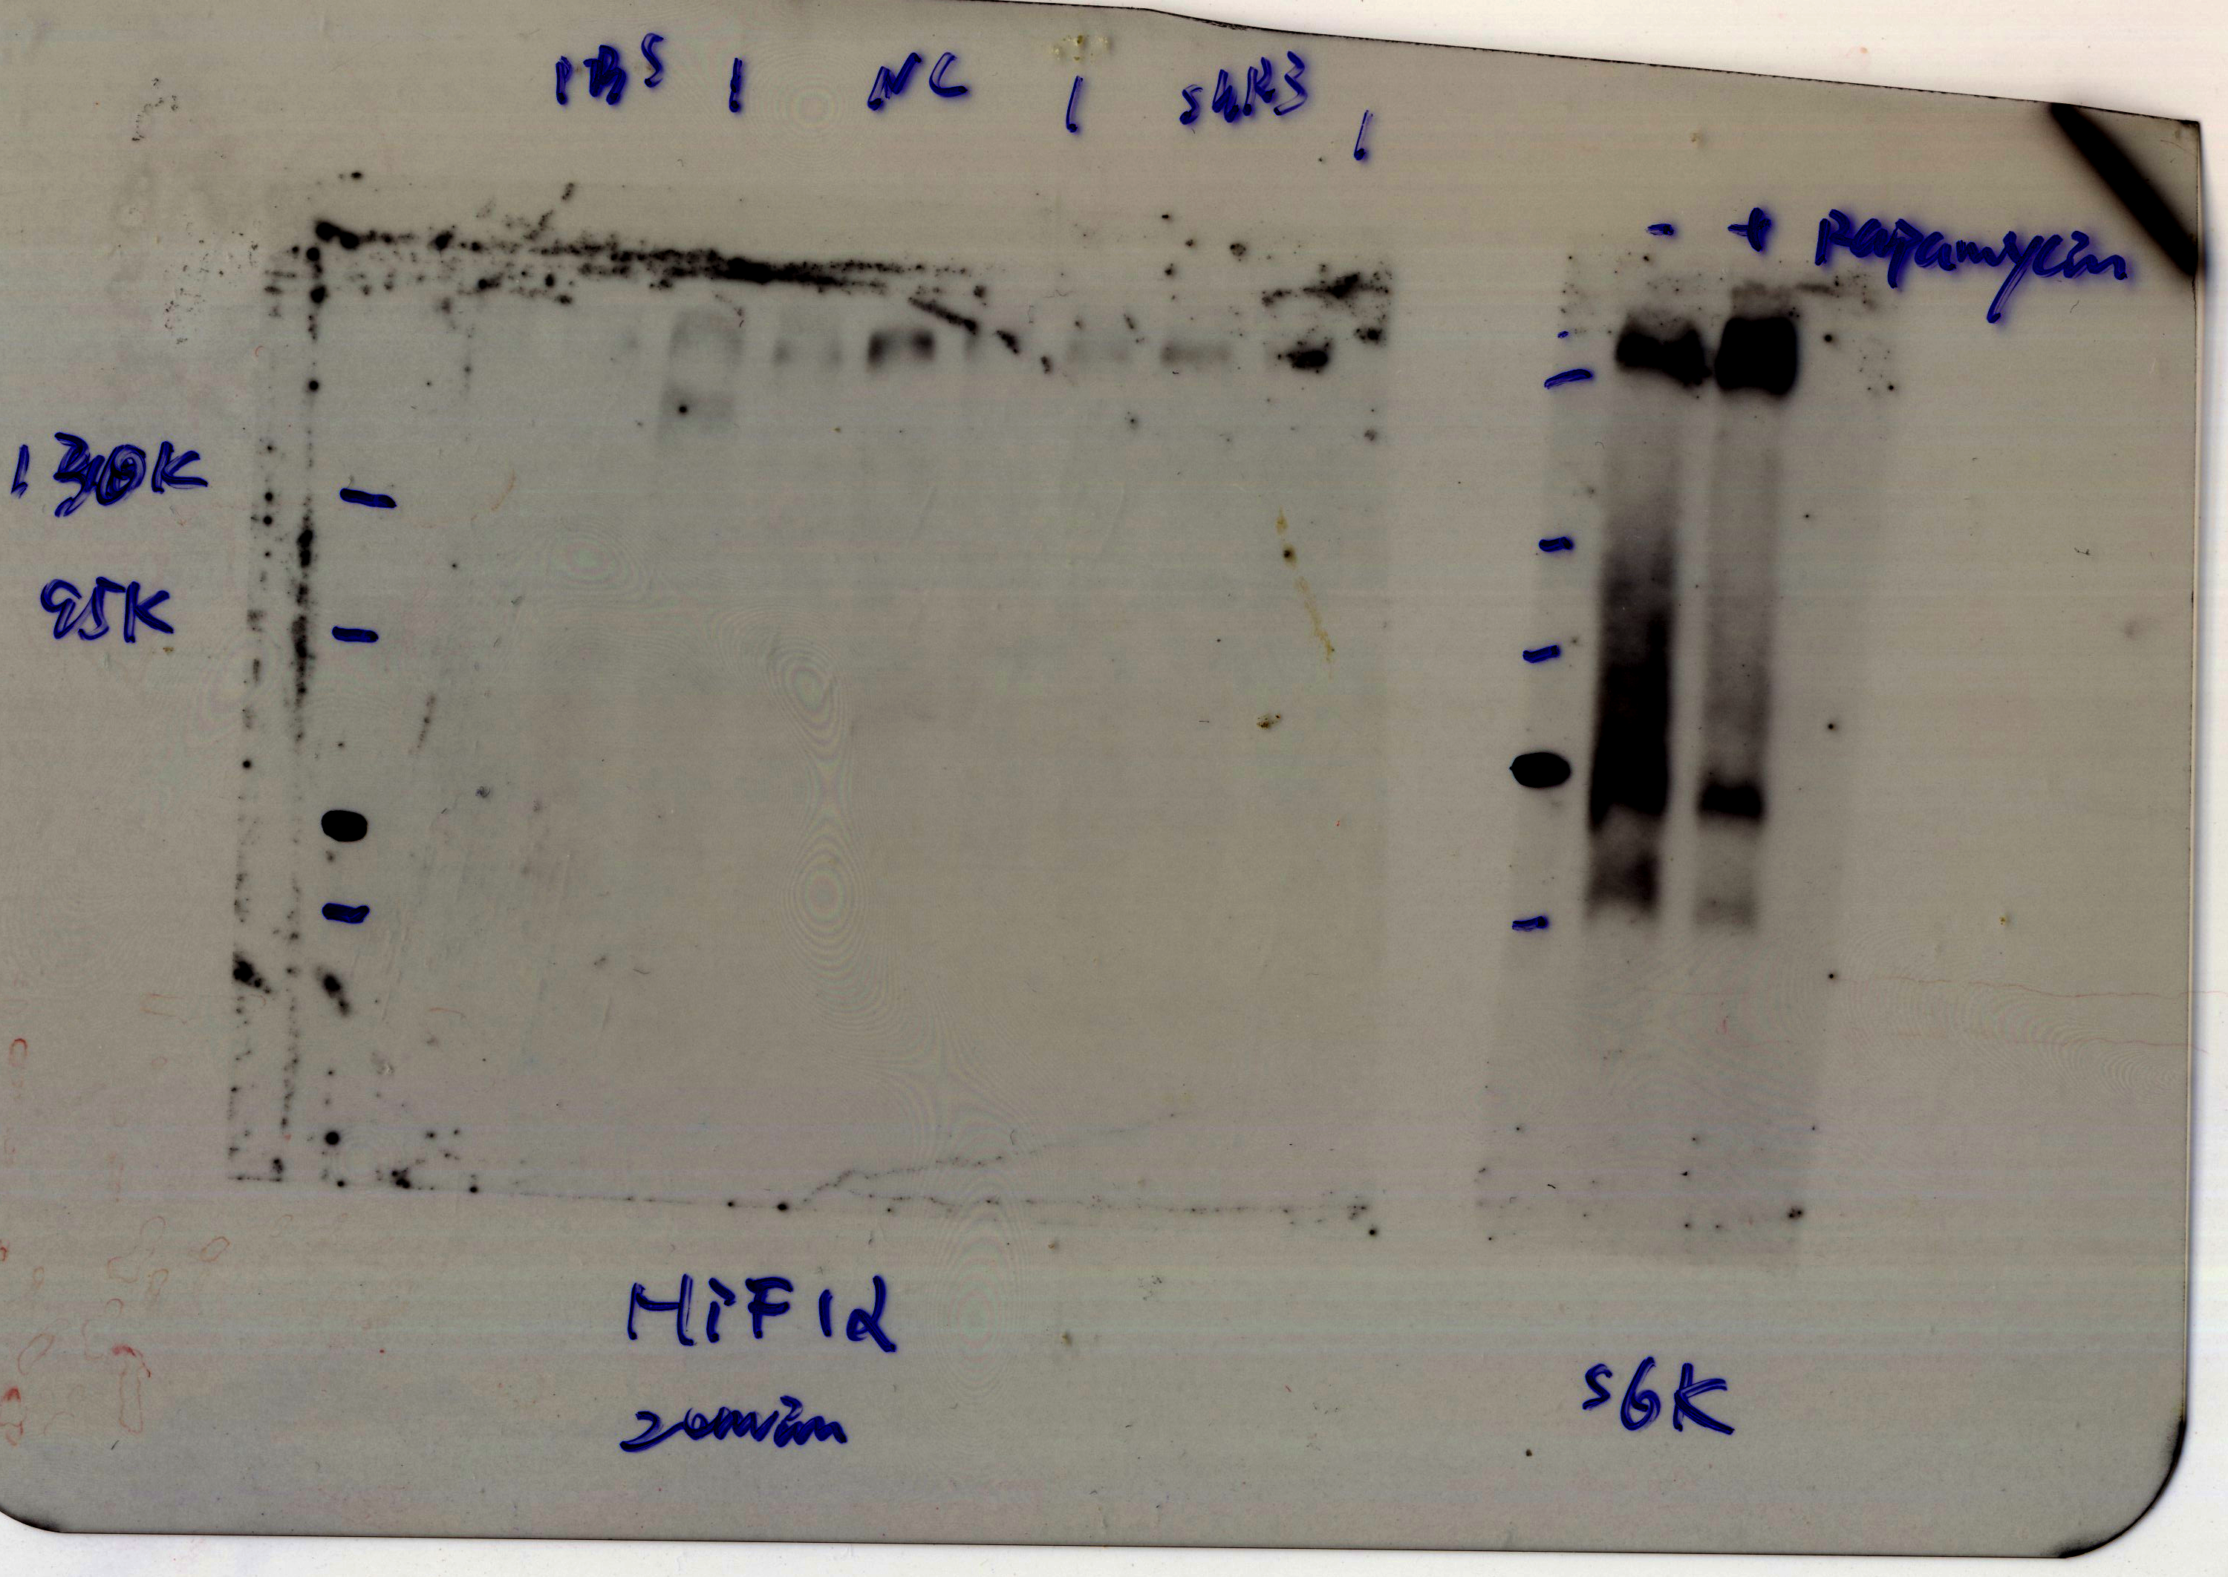
PhosTag separation of Hif1a into two bands

Slide 108
Increased glycolysis and lipogenesis in AD-PPP2R5C infected Hepa1-6
Notes:
Building shRNA, packaging into AV, infect cell for 24 hr, check at 48 hr. MOI = 100 or 200

Slide 109
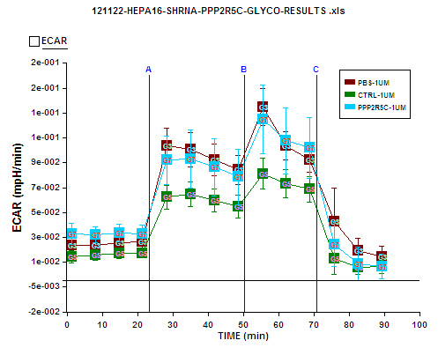
Glycolysis Stress with PPP2R5C KD
A = Glucose
B = Oligomycin
C = 2-DG

Slide 110
Increased Glycolysis in PPP2R5C KD

Slide 111
Large error bar in Seahorse could be due to variation in cell number

Slide 112
PPP2R5C’s TAG phenotype is mTOR independent
Notes:
Knocking down PPP2R5C is like an amplifier for lipogenesis.

Slide 113
Longer PPP2R5C KD increase more lipogenesis

Slide 114
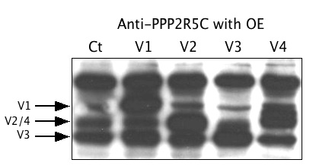
Antibody for PPP2R5C works for PPP2R5C OE

Slide 115
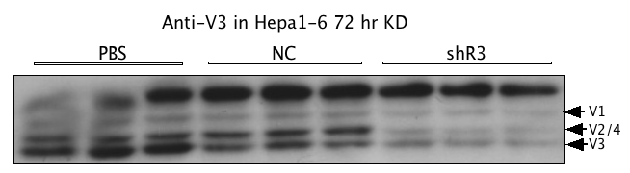
Significant KD of PPP2R5C by shR3

Slide 116
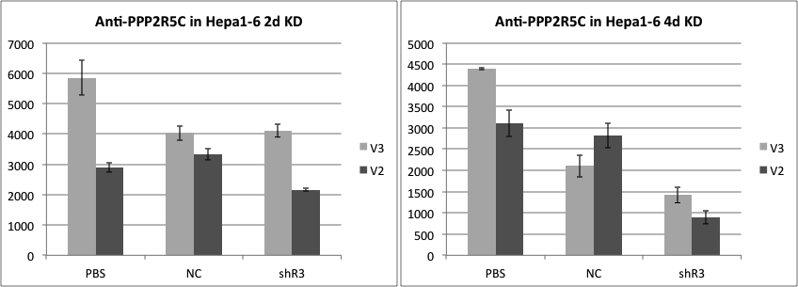
KD level correlates with TAG phenotype

Slide 117
How AAV is produced and purified
2x Cell culture and PEI transfection
3x Freeze/Thaw
Iodixanol discontinous gradient
Dialysis and Concentration
Titration

Slide 118
Most AAV lost in Gradient2

Slide 119
siRNA against PPP2R5C could reach 50% KD at transcription level

Slide 120
AAV-miR12 and siPPP2R5C could not reproduce TAG phenotype

Slide 121
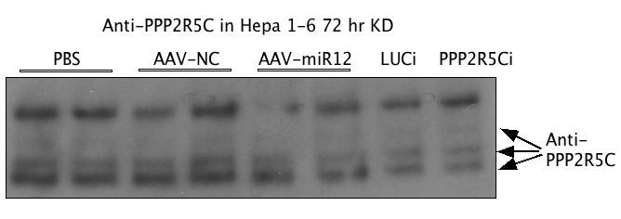
AAV and siRNA is not able to KD PPP2R5C

Slide 122
mTORC1 Activates Glycolysis and Lipogenesis
PPP2R5C
Duvel et al, Mol. Cell, 2010

Slide 123
Quality Control of HRE reporter

Slide 124
Top-down Target Selection
Substrate Trapping for PPP2R5C
X
X
X
P
P
*
PP2A
PP2A
Notes:
Ppp2a catalytic subunit active center. Metal ion depend enzyme. Mutant destabilized metal ion chelating or amino acid for charge transfer. 3 mutant, all binding with ppp2r5c and reported to be dead mutant.

Slide 125
PP2A catalytic mutant interacts with PPP2R5C

Slide 126
BioID protein interaction mapping
B
X1
B
PPP2R5C
BirA*
X2
X3
B
B
Streptavidin pulldown and Mass spec
Adapted from Roux et al, J. Cell Biol., 2012

Slide 127
Large scale streptavidin pulldown is successful
MycID-V1+D85N
V1-HAID+D85N
MycID-V1
HAID
V1-HAID
MycID

Slide 128
Hif1a interacts with PPP2R5C
Notes:
Not srebp

Slide 129
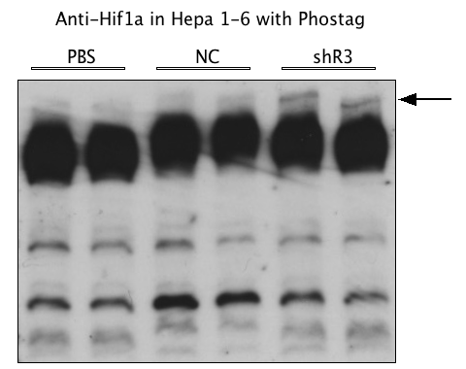
Hif1a is differentially phosphorylated

Slide 130
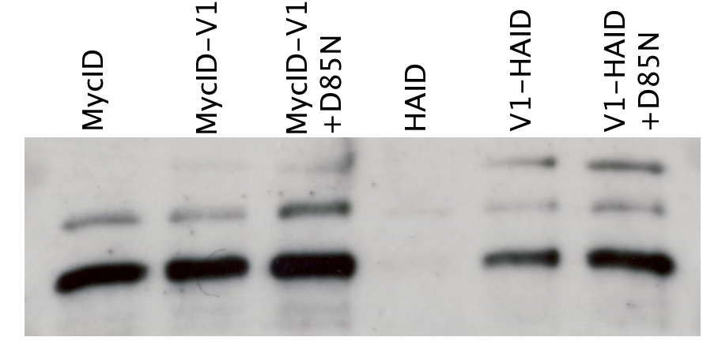
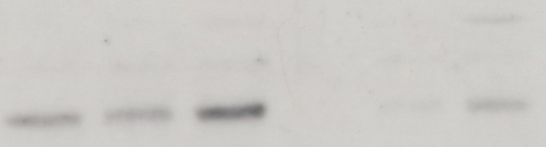
S6K interacts with PPP2R5C
Long Exp
Short Exp

Slide 131
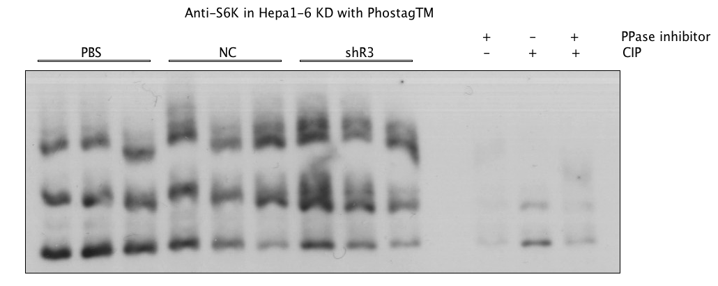
No evidence for S6K phosphorylation change

Slide 132
Interesting candidates from MS
Protein Name | mycID | mycID-V1 | mycID-V1+D85N | HAID | V1-HAID | V1-HAID + D85N
serine/threonine-protein phosphatase 2A 56 kDa regulatory subunit gamma isoform isoform a [Mus musculus] | 0 | 1343 | 1224 | 0 | 1306 | 1097
protein phosphatase 2 regulatory subunit B56 delta isoform [Mus musculus] | 3 | 346 | 313 | 0 | 296 | 262
Stat3 [Mus musculus] | 0 | 24 | 16 | 0 | 11 | 8
keratin 15 | 0 | 20 | 59 | 0 | 0 | 14
SH2-containing inositol 5-phosphatase 2 [Mus musculus] | 0 | 10 | 0 | 0 | 3 | 2
transcription factor junB [Mus musculus] | 2 | 6 | 6 | 0 | 4 | 0

Slide 133

STAT3 interacts with PPP2R
Notes:
Srebp, ampk, actin, tublin. No interaction

Slide 134

℗-STAT3(S727) is not change upon KD

Slide 135

No evidence for STAT3 phosphorylation change

Slide 136

SREBP is increased in 3day KD

Slide 137

SREBP could have more mature form

Slide 138

No evidence for cMYC phosphorylation change

Slide 139


AMPK is differentially Phosphorylated
Long expo

Slide 140
PPP2R5C negatively modulate AMPK

Slide 141
Generating virus-free stable cell line for inducible KD of PPP2R5C

Slide 142
Leakiness in single clone for shR3 and 6

Slide 143



Glucose uptake profile in Full Medium
2NBDG
Hepa1-6
shR3-2

Slide 144
Increased Glucose Uptake by 2NBDG assay

Slide 145
Glucose Uptake Percentage

Slide 146

Glucose Uptake Assay with 16h Starvation

Slide 147
Not all shR clones give same profile

Slide 148
There is at least one clone for each shR have the same glucose phenotype

Slide 149
Starved without cumate induction

Slide 150

Granularity differs in shRs
Hepa 16 shR3-4 shR8-2

Slide 151
Cell granularity differs in shRs upon PPP2R5C KD

Slide 152
PPP2R5C KD does not change cell size

Slide 153
Triglyceride storage phenotype is already developed in 48hrs
Notes:
Time course, even stronger at 72 hrs. With technial improvement. If you really care about your experiment, you should invent method for your own experiment.

Slide 154
PPP2R5C’s TAG phenotype is mTOR independent
Notes:
Knocking down PPP2R5C is like an amplifier for lipogenesis.

Slide 155
Inducible KD of PPP2R5C could not reproduce AV KD results

Slide 156
TAG phenotype is not consistent in stable cell lines
Notes:
Ampk counter act effect of s6k and hif1a on TAG

Slide 157
TAG at high cell density

Slide 158


Low Cumate induction
Hepa16 shR3-2 shR3-4
0 0.15 0.3 1 0 0.15 0.3 1 0 0.15 0.3 1 x Cumate
Hepa shR6-5 shR6-7
0 0 0.15 0.3 1 0 0.15 0.3 1 x Cumate

Slide 159
TAG at low induction low cell density

Slide 160
Top-down Target Selection
Substrate Trapping for PPP2R5C
X
X
X
P
P
*
PP2A
PP2A
Notes:
Ppp2a catalytic subunit active center. Metal ion depend enzyme. Mutant destabilized metal ion chelating or amino acid for charge transfer. 3 mutant, all binding with ppp2r5c and reported to be dead mutant.

Slide 161
BioID protein interaction mapping
B
X1
B
PPP2R5C
BirA*
X2
X3
B
*
B
PP2A
Streptavidin pulldown and Mass spec
Adapted from Roux et al, J. Cell Biol., 2012

Slide 162
Hif1a interacts with PPP2R5C
Notes:
Not srebp

Slide 163
Hif1a is differentially phosphorylated

Slide 164
S6K interacts with PPP2R5C
Long Exp
Short Exp

Slide 165
STAT3 interacts with PPP2R
Notes:
Srebp, ampk, actin, tublin. No interaction

Slide 166
PPP2R5C negatively modulate AMPK

Slide 167

AMPK activated by induction and PPP2R5C KD
Hepa16 shR3-2 shR6-5 shR8-4
0x 1x 0x 1x 0x 1x 0x 1x
pAMPK(T172)

Slide 168

Hif1a phosphorylation change upon PPP2R5C KD
Hepa16 shR3-2 shR6-5 shR8-4
0x 1x 0x 1x 0x 1x 0x 1x
Hif1a

Slide 169



CIP treatment for shR6-5 after induction
IP NP
RIPA
IP NP
RIPA
CIP - + - +
0x 1x 0x 1x 0x 1x 0x 1x Cumate
pS6K（T389)
- - + + - - + + CIP
Hif1a
pAMPK

Slide 170

S6K phosphorylation on phostag
IP NP
RIPA
0x 1x 0x 1x 0x 1x 0x 1x Cumate
- - + + - - + + CIP

Slide 171

AMPK phosphorylation change on phostag
IP NP
RIPA
0x 1x 0x 1x 0x 1x 0x 1x Cumate
- - + + - - + + CIP

Slide 172

Protein level of PPP2R5C in wt/db mices
WT db/db
Fasted Refed Fasted Refed
5.1 5.2 5.3 6.1 6.2 6.3 5.1 5.2 5.3 6.1 6.2 6.3
V1
V2/4
V3

Slide 173
Glucose Uptake Assay with 16h Starvation
2NBDG

Slide 174
There is at least one clone for each shR have the same glucose phenotype

Slide 175
BioID protein interaction mapping
B
X1
B
PPP2R5C
BirA*
X2
X3
B
*
B
PP2A
Streptavidin pulldown and Mass spec
Adapted from Roux et al, J. Cell Biol., 2012

Slide 176
S6K interacts with PPP2R5C
Long Exp
Short Exp

Slide 177
PPP2R5C negatively modulate AMPK

Slide 178


PPP2R5C could bind to AMPK b1
D85N+
D85N+
MID MID-V1 MID-V1 HID HID-V1 HID-V1
Anti-Hif1a
Anti-AMPK b1

Slide 179



KD of PPP2R5C affect AMPK activity
Hepa16 shR3-4 shR6-5 Hepa16 shR3-4 shR6-5
0x 1x 0x 1x 0x 1x 0x 1x 0x 1x 0x 1x
pAMPK T172
pACC1
AMPK alpha
Actinb

Slide 180


AMPK targets in glucose uptake activates upon PPP2R5C kd
AMPK
Hepa16 shR3-4 shR6-5
0x 1x 0x 1x 0x 1x
Ⓟ
P-S660-TBC1D1
AS160/TBC1D1
P-S700-TBC1D1
Translocation
Glut4
TNXIP

Slide 181
Epistasis by AMPK chemical inhibition

Slide 182

Compound C does not give effective AMPK inhibition
0x 1x Cumate
DMSO Comp C DMSO Comp C
H 3 6 H 3 6 H 3 6 H 3 6
pAMPK
AMPK

Slide 183


Time dynamics of Compound C on AMPK inhibition
0 1 2 4 6 8 16 24 hrs 10uM Comp C
pAMPK
AMPK

Slide 184
Compound C from santa cruz
4 4 4 4 4 4 0 1 2 4 6 8 hrs treatment
0 1 3 10 30 100 10 10 10 10 10 10 uM BML-275
pAMPK
AMPK
Notes:
----- Meeting Notes (11/26/13 10:46) -----
starved

Slide 185




AMPK dephosphorylation assay is not reproducible
1hr HA V1 CIP
HA V1 HA V1
pAMPK
tAMPK
AMPK b1 S108?

Slide 186
Glucose Uptake in Primary Hepatocytes

Slide 187

Glucose Uptake in Primary Hepatocytes

Slide 188



AMPK in primary hepatocytes
pAMPK
tAMPK
pACC

Slide 189

PPP2R5C controls glycolysis via AMPK pathway
Notes:
----- Meeting Notes (11/26/13 10:46) -----
glut4 staining for tanslocation

Slide 190
Triglyceride storage phenotype is already developed in 48hrs
Notes:
Time course, even stronger at 72 hrs. With technial improvement. If you really care about your experiment, you should invent method for your own experiment.

Slide 191
PPP2R5C’s TAG phenotype is mTOR independent
Notes:
Knocking down PPP2R5C is like an amplifier for lipogenesis.

Slide 192
Hif1a interacts with PPP2R5C
Notes:
Not srebp

Slide 193
Hif1a phosphorylation change upon PPP2R5C KD
Hepa16 shR3-2 shR6-5 shR8-4
0x 1x 0x 1x 0x 1x 0x 1x
Hif1a

Slide 194
CIP treatment for shR6-5 after induction
IP NP
RIPA
IP NP
RIPA
CIP - + - +
0x 1x 0x 1x 0x 1x 0x 1x Cumate
pS6K（T389)
- - + + - - + + CIP
Hif1a
pAMPK

Slide 195
Hif1a target expression

Slide 196
Hif1a target expression
Notes:
----- Meeting Notes (11/26/13 10:46) -----
virus on primary hepa on hif1 targets and hif1a phostag

Slide 197
Hif reporter activity increases after induction

Slide 198
Hif reporter assay is not reproducible

Slide 199

SREBP in primary hepatocytes
HIF1a
PBS NC shR PBS NC shR
Precursor
Mature
SCAP
SREBP
SREBP

Slide 200

PPP2R5C could inhibit lipogeneis via HIF1a

Slide 201
In vivo mouse metabolism by KD PPP2R5C via AAV

Slide 202

AAV knockdown is finally successful
1x10^11 0.5x10^11
miRNC miR12 miRNC miR12
1.1 1.2 1.3 2.1 2.2 2.3 3.1 3.2 3.3 3.4
GP anti PPP2R5C

Slide 203
Body weight change during AAV KD pilot experiment

Slide 204
Blood glucose profiles

Slide 205
Liver weight are higher in KD groups

Slide 206

Working model for PPP2R5C in metabolism control

Slide 207



PPP2R5C KD efficiency
miRNC miR12
Random
PPP2R5C
Fast
PPP2R5C
Refed
PPP2R5C

Slide 208
No significant change in total body fat

Slide 209
Increased Insulin Sensitivity in GTT

Slide 210
Faster glucose clearance

Slide 211
No Body Weight Change

Slide 212
No Blood Glucose Change

Slide 213
Increased Liver Weight

Slide 214
No change in Abdominal Fat

Slide 215
Increased Glycogen Storage

Slide 216
Lower Blood Insulin

Slide 217
Better Insulin Sensitivity

Slide 218
TAG patterns depend on nutritional status

Slide 219
No change in serum TAG

Slide 220
Outliers in liver NEFA explains lower statistical significance of TAG

Slide 221
Increased serum NEFA during refed

Slide 222
Lower liver cholesterol

Slide 223
No change in serum cholesterol

Slide 224
No change in serum total ketone body

Slide 225
No change in serum hydroxybutyrate

